Slide 1



Publishing and Consuming Geo-Spatial Government Data on the Semantic Web
Ghislain Auguste Atemezing
Multimedia Department, Eurecom
Supervisor:
Dr. Raphaël Troncy, MM Department, Eurecom

Slide 2
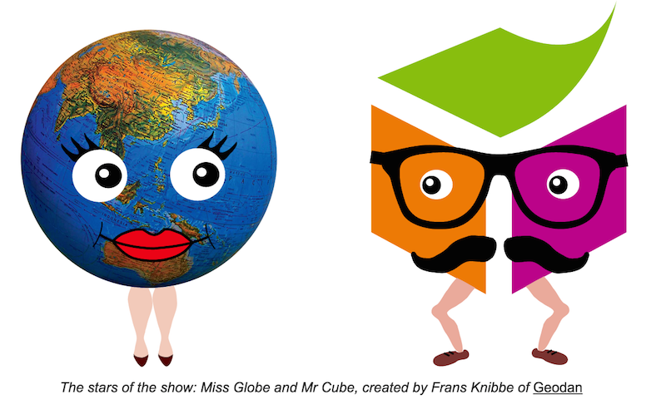
The stars of this presentation….

Slide 3
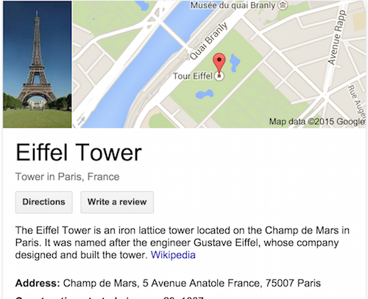

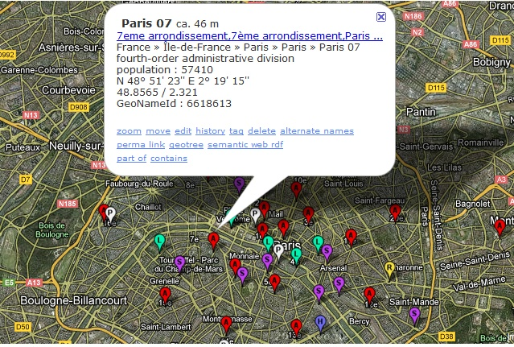
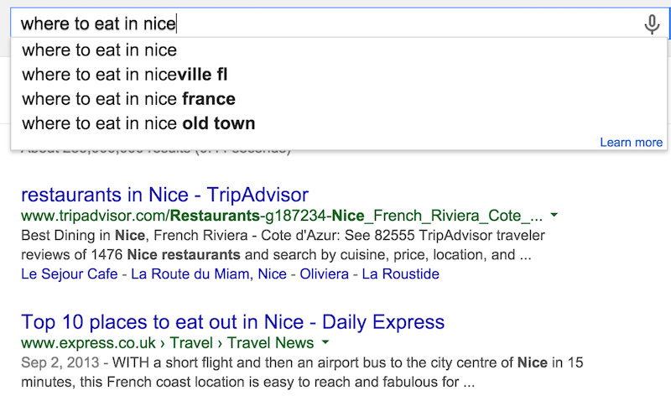

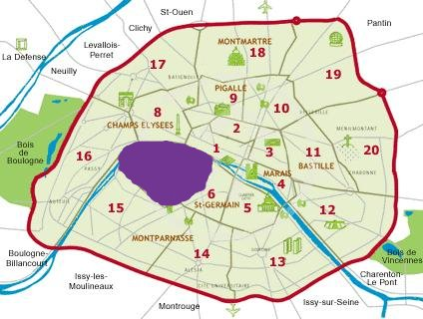
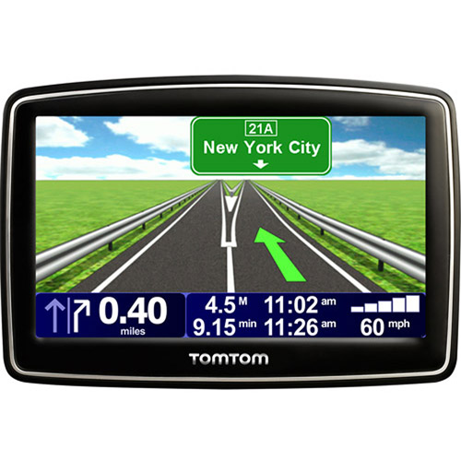
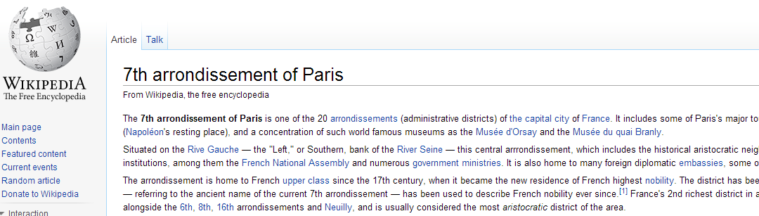
Geospatial data: why it matters?
“80% of needs for decisions from public authorities have a geospatial component”.
(Philippe Grelot, IGN-France)

Slide 4
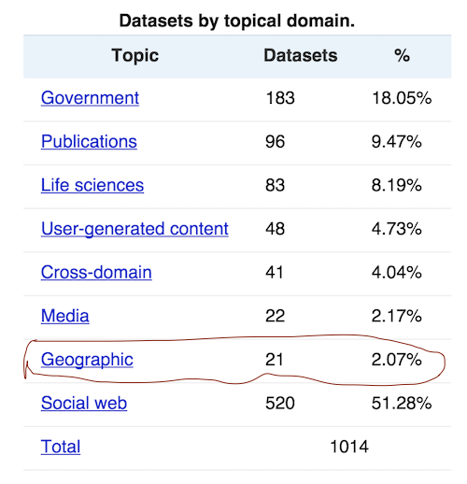
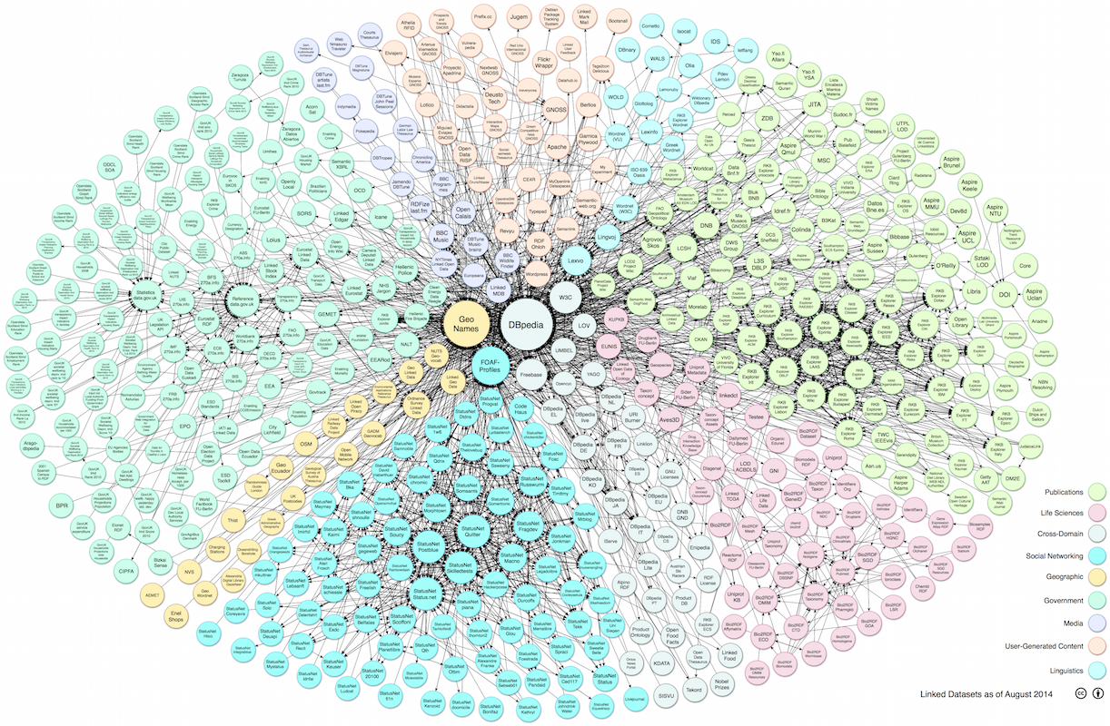
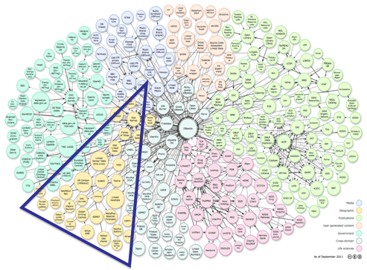
GeoData on the LOD Cloud
http://lod-cloud.net/versions/2014-08-30/
Linking Open Data cloud diagram 2014, by Max Schmachtenberg, Christian Bizer,
Anja Jentzsch and Richard Cyganiak.
http://lod-cloud.net/
In 2011 19,43% →31 geo-datasets in LOD
http://lod-cloud.net/state/

Slide 5
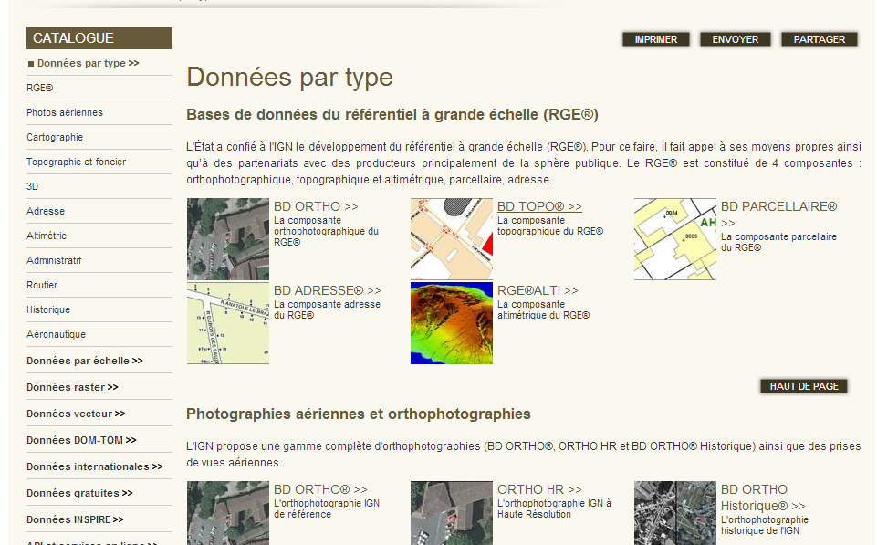
French IGN- Reference Geodata
« ..describes the French national territory and the occupation of its land, elaborates and updates perpetual inventory of the forest resources »
Different databases with overlapping information: BD ORTHO, BD PARCELLAIRE, POINT ADRESSE, BD ALTI 25m, BD TOPO; etc.
CRS: LAMBERT93 or RGF93
Q: ”Give me all the bridges in a radius of 2km from the "Eiffel Tower“?
A: Not straightforward
Notes:
Files available in SHP, pdf
Information overlap in different products, sometimes referring to the same « real world » concepts.

Slide 6
Research Questions
How to efficiently represent and store geospatial data on the Web to ensure interoperable applications?
the publication of real datasets
the interlinking with other datasets having overlapping coverage
What are the best options for a user to discover, browse and interact with semantic content?
Can we propose a generic model for visualizing semantic content?
What are the mechanisms to help preserving structured data of a high quality on the Web?
How to improve reusing vocabularies for better interoperability
How to detect incompatibility between data and metadata
Notes:
The answers to these Use Cases need to do some screen scraping on different html pages of data portals where the applications are described, sometimes without many information nor description.

Slide 7
Outline
Introduction
Research Questions
Contributions
Semantic publication of geospatial data
Visualizations of Government Linked Data
Best Practices for metadata in vocabularies
Conclusion
Publications

Slide 8
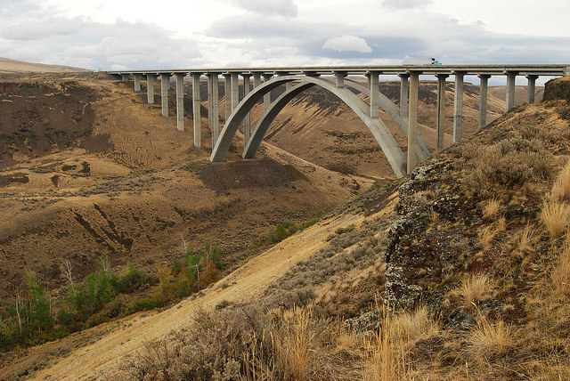
Semantic Publication of Geospatial Data

Slide 9
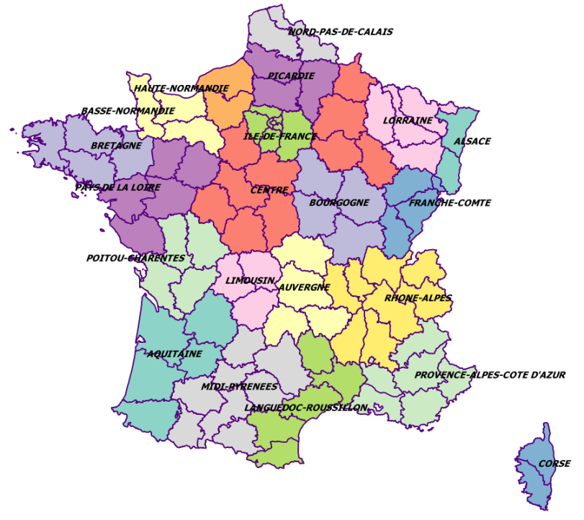
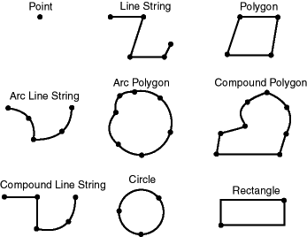
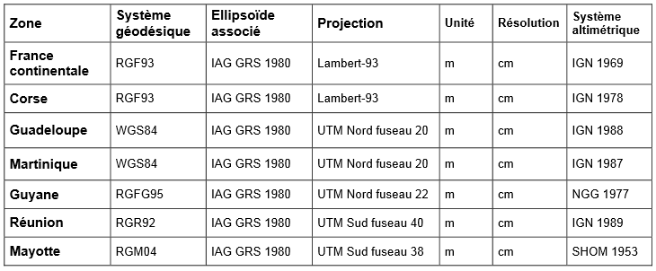
Modeling Geospatial Objects
Two main components:
Features and Geometry
within a CRS.

Slide 10
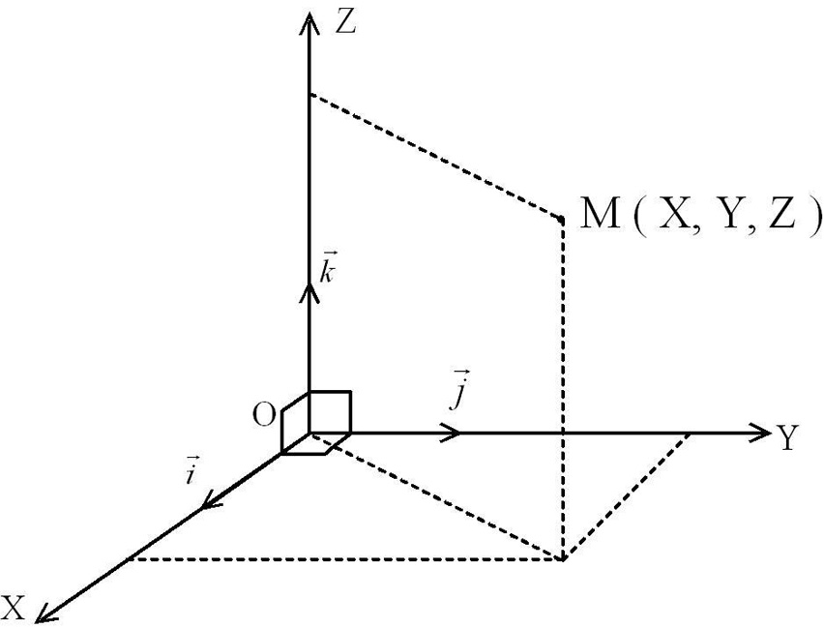
Coordinate Reference Systems (CRS)
CRS: A representation of the locations of geographic features within a common geographic framework
Each CRS is defined by its measurement framework
Geographic: spherical coordinates (unit: decimal degrees)
Planimetric: 2D planar surface (unit: meters) + a map projection
Additional measurement properties: ellipsoid, datum, standard parallels, central meridians, etc
Hundred of CRSs: (WGS84, ETRS89, etc.)
Thousands of Projected CRSs: (UTM, Lambert93, etc.)

Slide 11
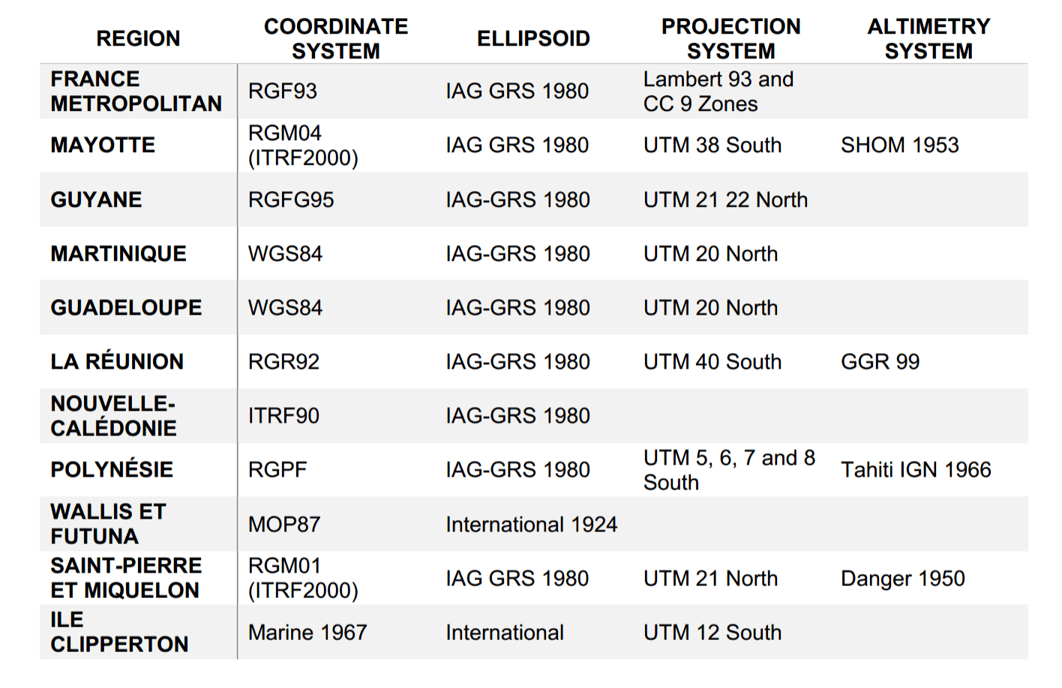
CRSs in France (Metropolitan +Overseas)
10 CRSs coverage (mostly RGF93)
10 projections (mostly used Lambert 93)
3 different frameworks
The Web only uses de facto WGS84
Publishers need converters for their data

Slide 12
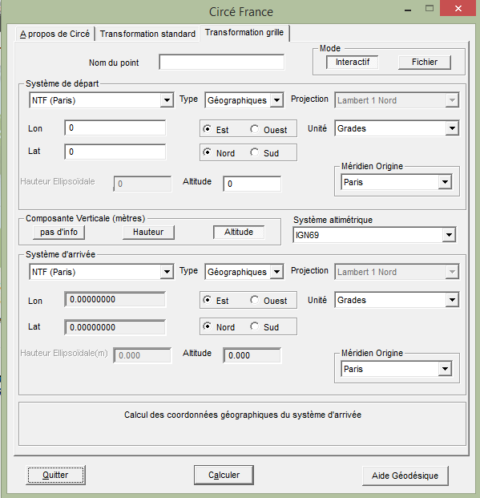
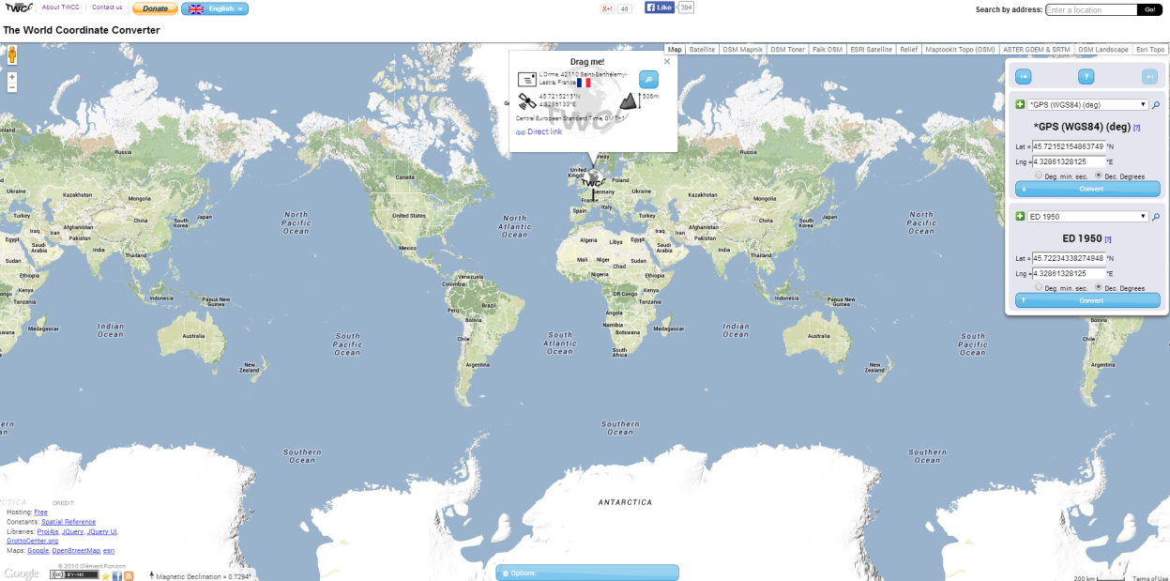
CRS Converters and Limitations
Circé: A Converter Software from IGN
Allows conversion between some France CRSs
to WGS84
Closed Source, No open service
Existing Web tools (e.g., world coordinate converter)
No open service, closed source
Converting algorithms don’t usually map to any national mapping authority.

Slide 13
Developing a REST converter service
International Communication
Many regional's’ published data involve with local CRS
A medium
Interpret the coordinates between these CRSs
A Converter Service
Open services for community
RESTFul Web Service
A web based service to perform conversion between various CRSs
WGS 84 <–> Lambert 93
WGS 84 <–> UTM
GOOD accuracy of the results

Slide 14
Vocabularies for Modeling Features (1/2)
Authority list of terms (e.g. Foursquare)
Less structured
Represent categories of Points of Interest (POIs)
Typically, one type as an API answer
Need to express the semantics of the terms
SKOS Categories (e.g. GeoNames)
Classes are skos:conceptScheme
Codes are skos:Concept
Few classes … BUT many codes

Slide 15
Vocabularies for Modeling Features (2/2)
Domain specific ontologies
One ontology per subdomain (transport, administrative unit, hydrography, etc.)
Interconnected ontologies (by explicit semantic e.g. owl:imports)
UK (OS) – ES (GeoLinkedData)
Some richer ontologies created by (semi-)automatic tools / NLP
Deeper taxonomy to structure the ontology
LinkedGeoData: 16 high-level classes, 1294 classes
GeOnto: 2 high-level classes, 783 classes in total

Slide 16
Modeling Geometry: State of the Art
Point (lat/long)
WGS 84 vocabulary described by W3C
Rectangle (“bounding box”)
Geopolitical Vocabulary (FAO)
Points in a List
Sequence of points (LinkedGeoData)
An object is “formedBy” a ListOfPoints (GeoLinkedData.es)
Literals (GML datatype in RDF)
Ordnance Survey (UK)
More structured representation of complex geometry
NeoGeo Vocabulary (GeoVocamp), http://geovocab.org/
Notes:
Five approaches for modeling the Geometry: Point, Rectagne, Points in a List, Points in a group of RDF resources, Literals and more structured

Slide 17
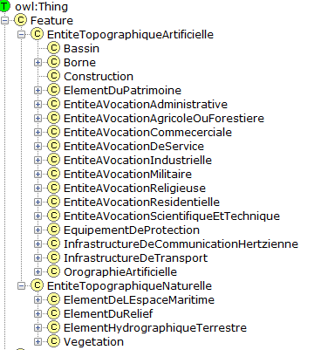
Reusing Existing Ontologies (GeOnto)
Ontology for geographic objects (POI)
Output of a French (ANR) research project
Obtained from NLP tools
Classes in French
rdfs:labels in FR & EN
Few owl:ObjectProperty
783 classes
Overlap with other vocabs
Need for alignment

Slide 18
Aligning GeOnto with existing Ontologies
Alignment of GeOnto with 4 ontologies and 2 flat taxonomies
LGD, DBpedia, Schema.org, GeoNames
Foursquare, Google Places
Goal: finding owl:equivalentClass
Tool : Silk framework
Metrics : LevenshteinDistance,Jaro
Labels : @en des classes
Aggregation Function: Mean
Silk
Look for skos codes that matches GeOnto classes
Verify the links <70%
SPARL Endpoint
Use SPARQL « Construct » to generate a new graph.
Alignment File
Export the rdf file
Generate « sameAs » links
Specific alignments with GeoNames codes

Slide 19
Alignment Process (GeoNames)– Results
Vocab/taxonomies | #Classes | #Classes aligned
LGD | owl:Class: 1294 | 178
DBpedia | owl:Class: 366 | 42
Schema.org | owl:Class: 296 | 52
GeoNames | skos:Concept: 699 | 287
Foursquare | 359 | 46
Google Place | 126 | 41
bdtopo | owl:Class: 237 | 153
High precisions > 80%
BUT P(Schema.org) = 50%. →
GeOnto entities are more specific to France
Schema.org contains more specific terms

Slide 20
Proposal: CheckList for modeling geodata
Complex Geometry Coverage
Need to publish more data with complex geometries
Reuse and extend suitable ontologies (NeoGeo, GeoSPARQL)
Features MUST be connected to Geometry
Sometimes it may requires two namespaces
Serialization
Provide serialization in other GIS formats (GML, WKT, KML, etc.)
Literal vs Structured Representation
Use of structured representation for complex geometry
Need to reuse part of a geometry (some requirements of IGN)
Notes:
GeoSPARQL needs to be published with (de)-referenceable URIs?! We want to have GeoSPARQL in the LOV catalog.

Slide 21
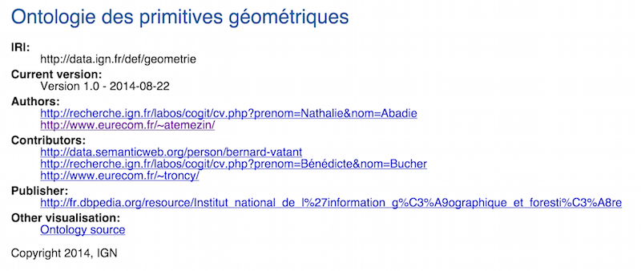
Proposal: A Vocabulary for complex Geometry
Extending and reusing existing vocabularies
Available at http://data.ignf.fr/def/geometrie
@prefix ngeo: <http://geovocab.org/geometry#>.
@prefix sf: <http://www.opengis.net/ont/sf#>.
[…]
geom:Geometry a owl:Class;
rdfs:comment "Primitive géométrique non instanciable, racine de l'ontologie des primitives géométriques. Une géométrie est associée à un système de coordonnées et un seul."@fr;
rdfs:label "Géométrie"@fr, "Geometry"@en;
owl:equivalentClass [ a owl:Restriction;
owl:onClass ignf:CoordinatesSystem;
owl:onProperty geom:crs;
owl:qualifiedCardinality "1"^^xsd:nonNegativeInteger];
rdfs:subClassOf ngeo:Geometry;
rdfs:subClassOf sf:Geometry.
Notes:
GeoSPARQL needs to be published with (de)-referenceable URIs?! We want to have GeoSPARQL in the LOV catalog.

Slide 22
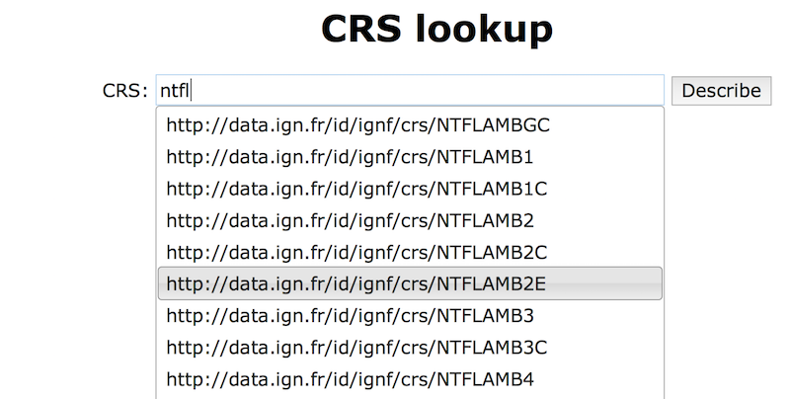
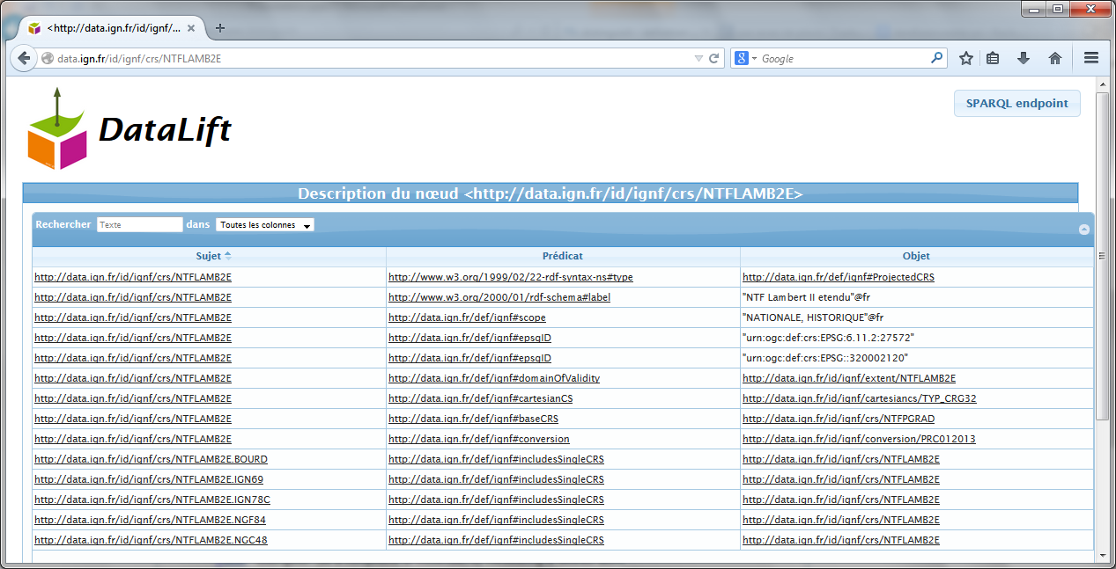
Associating CRS to Geometries
A vocabulary for describing CRS
Subset of ISO 19111 model
Available at http://data.ignf.fr/def/ingf
A dataset for French CRS in RDF
Convert from XML data published by IGN France to RDF
Unique URIs for each CRS
Eg: “Lambert 2 étendu” http://data.ign.fr/id/ignf/crs/NTFLAMB2E
Notes:
GeoSPARQL needs to be published with (de)-referenceable URIs?! We want to have GeoSPARQL in the LOV catalog.

Slide 23
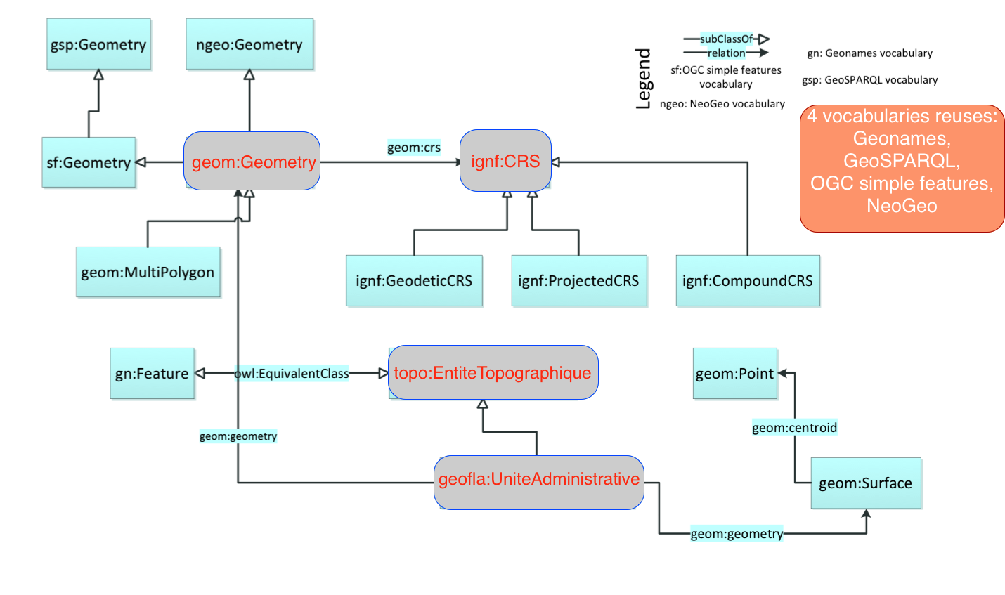
Overview of the vocabularies and relationships
Notes:
GeoSPARQL needs to be published with (de)-referenceable URIs?! We want to have GeoSPARQL in the LOV catalog.

Slide 24
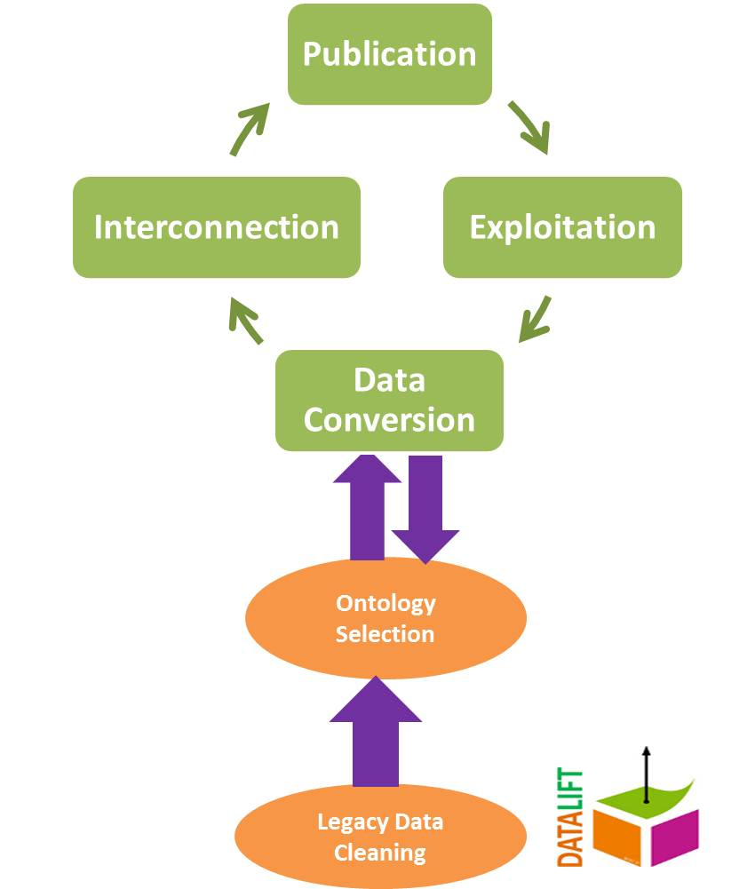
A workflow for publishing Linked(Geo)Data
Datalift: A SET of modular tools
for “lifting” raw data in rdf.
Notes:
GeoSPARQL needs to be published with (de)-referenceable URIs?! We want to have GeoSPARQL in the LOV catalog.

Slide 25
Publishing French Reference Geodata in RDF
GEOFLA® Dataset on French administrative units in rdf
Features are of type http://data.ign.fr/geofla
French gazetteer dataset
Features are of type http://data.ign.fr/topo
Mapping results with external dataset
DATASET GEOFLA DATASET |  | #mappings | Tool
 | INSEE | 37,020 | SILK
 | DBPEDIA-FR | 23, 252 (communes) and 93 departments | LIMES
 | NUTS | 105 (16 regions) | SILK
 | GADM | 70 | SILK
FRENCH GAZETTEER | LINKED GEODATA | 654 (lgdo:Amenity) | LIMES

Slide 26
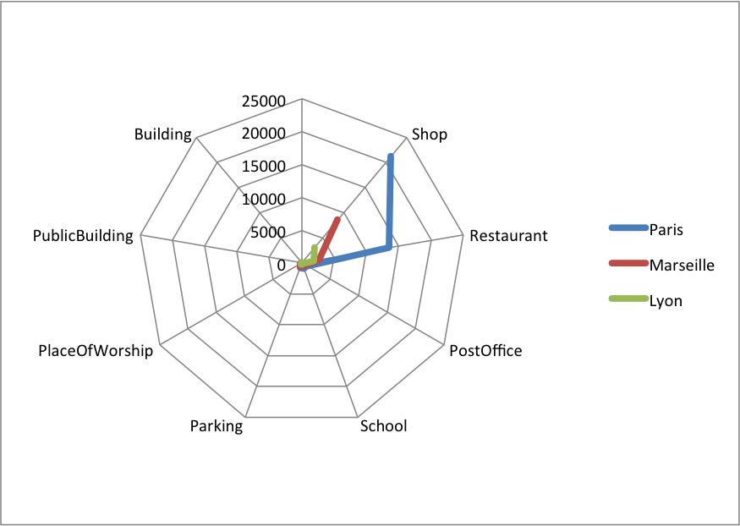
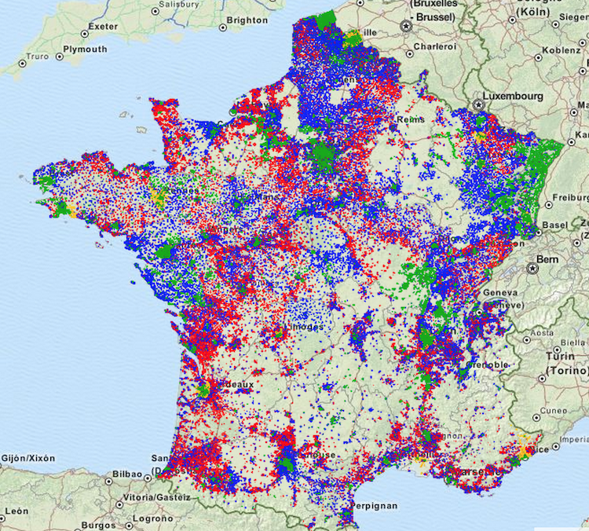
French Open Addresses in RDF Mappings
LGData Amenities | Paris (248052) |  | Marseille (401404) |  | Lyon (89061)
 | #matched | %matched | #matched | %matched | #matched | %matched
Shop (778680) | 21171 | 2.71 | 8556 | 1.098 | 3049 | 0.391
Restaurant (260675) | 13567 | 5.204 | 2654 | 1.018 | 1882 | 0.721
PostOffice (87731) | 971 | 1.106 | 555 | 0.632 | 173 | 0.197
School (318287) | 883 | 0.277 | 411 | 0.129 | 197 | 0.061
Parking (250516) | 735 | 0.293 | 625 | 0.24 | 210 | 0.083
PlaceOfWorship (357445) | 272 | 0.076 | 193 | 0.053 | 31 | 0.008
PublicBuilding (26735) | 97 | 0.362 | 64 | 0.239 | 21 | 0.078
Building (22283) | 5 | 0.022 | 12 | 0.053 | 0 | 0
BANO2RDF

Slide 27
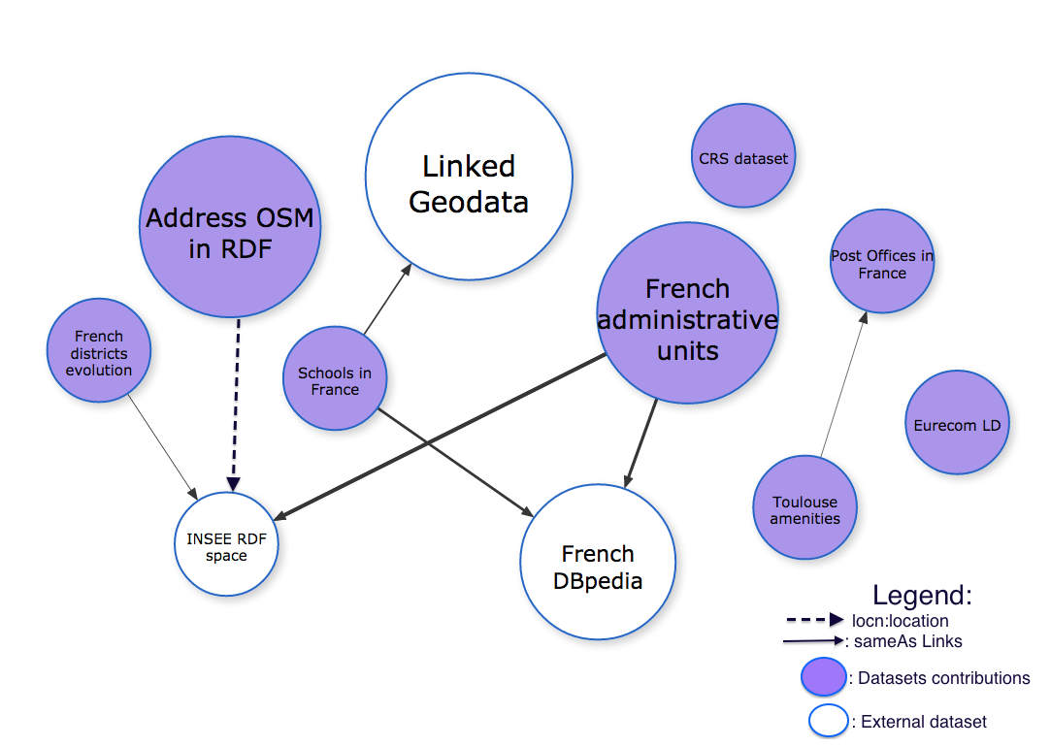


Contribution to the LOD Cloud (FrLOD)
340 millions of triples in RDF (10% of DBPedia 2014)
BUT …
"if you use our Linked Data please let us know, or we might switch it off." (OS)

Slide 28


Why Visualizations Matters
“Don’t ask what you can do for the Semantic Web;
ask what the Semantic Web can do for you!” (D. Karger, MIT CSAIL) –
1- How to build bridge to fill the gap between traditional InfoVis tools
and Semantic Web technologies
2- How can Semantic Web help in visualization?

Slide 29
Types of Visualization in Government Portals
Study of applications consuming Open Data
Countries: UK (7), USA (3) and France (3)
Number of applications: (13)
Domain: education, health, transport, government, city, housing, criminality, foreign aid
Classification dimensions
Platform (web, mobile), data sources, which views are available (maps, charts, timeline, etc.)
URL policy for identifying data objects
License for the application / for the data
Commercial / non-commercial

Slide 30
Linked Data Application Categories (*)
Generic applications
Used to browse any RDF graph (e.g: Tabulator, OpenLink Data Explorer)
Vocabulary-specific applications
Built around particular vocabularies (e.g.: FaceBook Social Graph API, IsaViz, CubeViz)
Data-specific applications (mashups)
Built around particular datasets (e.g. Where does my money go, IOGDS: International Open Government Dataset Search)
(*) Classification according to:Jeni Tennison : http://www.jenitennison.com/blog/node/126

Slide 31
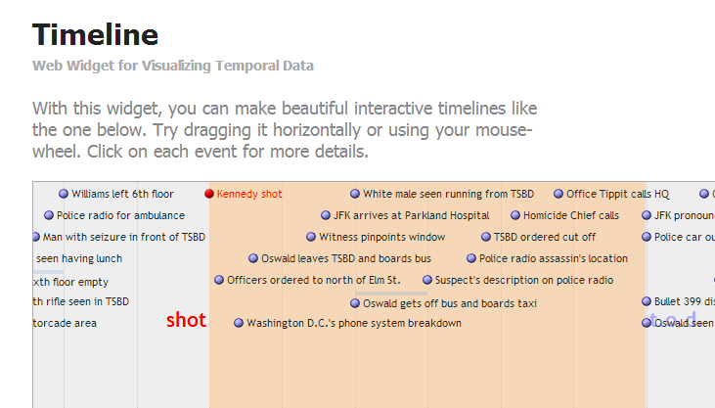
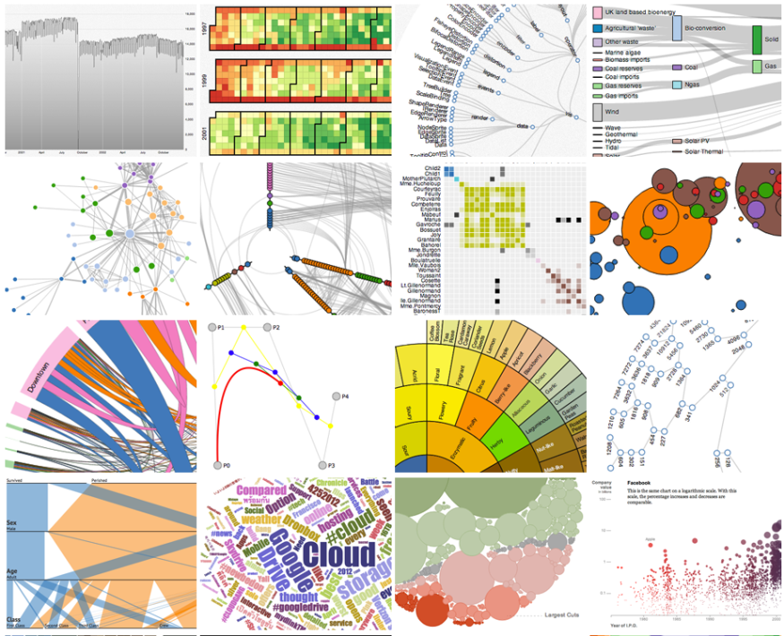
Relevant Features in Visualization Tools
Data format given as input (csv, xml, shp, rdf, etc.)
Data access (API, dump, etc.)
Language code
Type of view
External Libraries
License
Metadata: author, organization
Notes:
Importance of each feature:
* Data formats: the type of the format could lead to the decision of creation a converter layer before the visualization layer.
Data access: defines how to get the data, such as simple dump, API, SPARQL endpoint
Language code: this helps deciding also for the integration of tool.
Type of view is essential depending on the type of the data to display. E.g: if the tool does not provide timeline view, it could be difficult to want to create a visualization making use of timeline.
* External libraries are useful for integration compatibility.
* License for reusability of the tool
* Author/creator for metadata mention of the owner or the tool

Slide 32
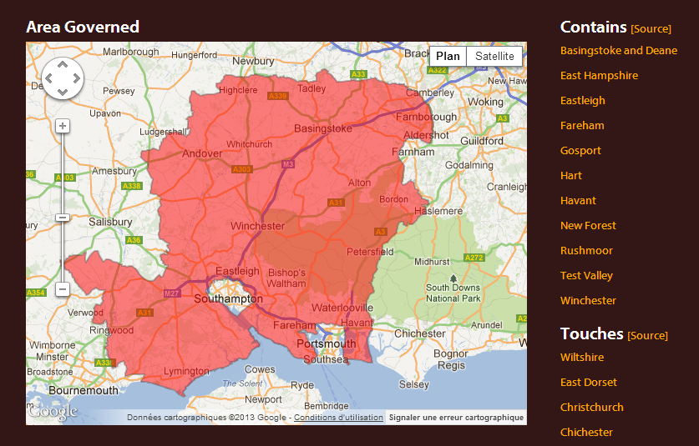
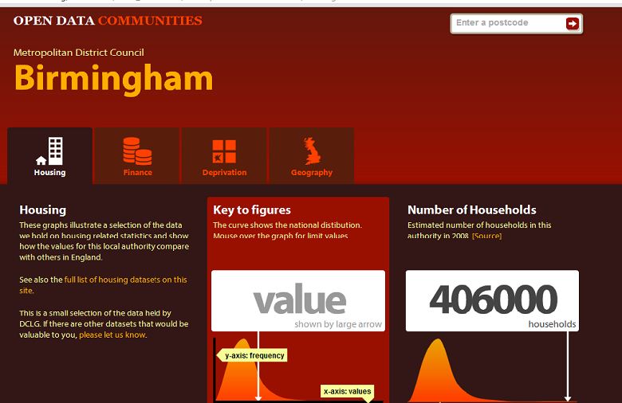
Describing an Application: Opendatacom
Scope/Domain: Department for Communities and Local Government, datasets access
Description: visualize available datasets (finance, housing, deprivation, geography) by authorities or postcode.
On the dashboard, it provides graphs showing the national distribution of a district and how the values for this local authority compare with others in England.
Supported Platform: Web
URL Policy: http://{domain}/id/{...} with redirection to the corresponding document at: http://{domain}/doc/{...}.
Hampshire County Council is: http://opendatacommunities.org/id/county-council/hampshire
Data Sources: 36 datasets from DCLG, Administrative Geography and Postcodes from Ordnance Survey.
Type of View: Graph, Map views.
Visualization Tools: google visualization API, raphael.js
License: Open Government license [OGL]
Business Value: Non commercial

Slide 33
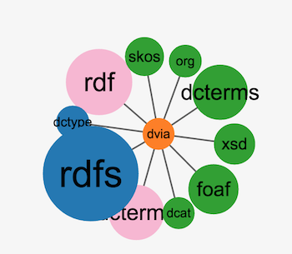
DVIA: A vocabulary to describe Applications
dctype:Software
Prefixes:
@prefix dct: <http://purl.org/dc/terms/>.
@prefix dcat: <http://www.w3.org/ns/dcat#>.
@prefix dctype: <http://purl.org/dc/dcmitype/>.
@prefix org: <http://www.w3.org/ns/org#>.
@prefix dvia: <http://data.eurecom.fr/ontology/dvia#>.
dvia: Application
dvia: Platform
org:Organization
dct:title
dvia:description
dvia:keyword
dvia:url
dct:creator
dvia:businessValue
dvia:scope
dvia:view
dct:title
dvia:system
dvia:preferredNavigator
dvia:alternativeNavigator
dvia:designBy
dvia:platform
dvia:usesTool
dvia:consumes
dcat: Dataset
dvia: VisualTool
dct: title
dcat: accessURL
dct:references
dcat: keyword
dct:title
dct:description
dvia:accessUrl
dvia: downloadUrl

Slide 34

DVIA in Real World Datasets
Applications using DVIA
Use to populate 22 past events of hack-athons in Europe, with 889 applications from Apps4Europe.
Implementation of a universal JavaScript plugin to embed RDFa in organizers events.
An extension for Wordpress uses DVIA.
Notes:
*The Apps4Europe project, recently release a big catalog of all Apps in Europe and the goal now is to make some script for populating DVIA.
* Towards Linked Open Visualizations (LOVIZ) catalog

Slide 35
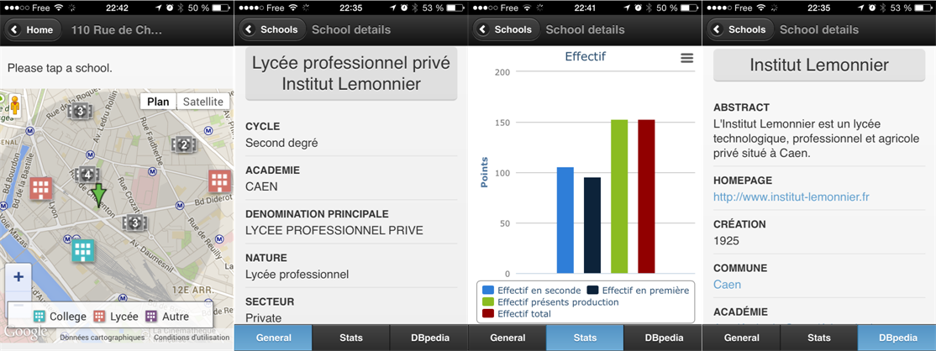
Developing Applications: from specific to generic
Scenario 1:
Known Datasets, Known vocabularies → Specific SPARQL queries
Visualizations: dataset specific
Example
Datasets on schools in France
Vocabularies: geo vocab, data cube, geometrie,
Application: PerfectSchool

Slide 36
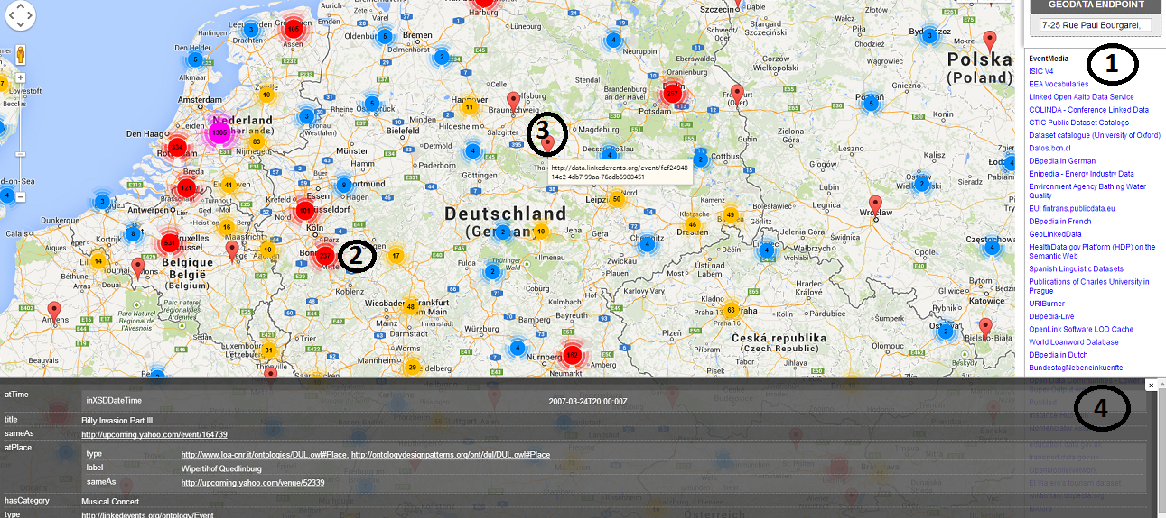
Developing Applications: from specific to generic
Scenario 2:
Unknown Datasets, Known domains, so domain-specific SPARQL queries
Visualizations: domain specific
Example
Endpoints of geodatasets
Domain: geospatial
Application: GeoRDFviz

Slide 37
A Journey of a Web Application developer
Scenario 3:
Unknown Datasets, Unknown domains, so generic SPARQL queries
Visualizations: adapted to domains specific
Example
Any endpoints
Multiple domains: geodata, statistics, persons, cross-domains, etc..
Application: ?????
Related work on configuring Semantic Web widgets by data mapping. [1]
Application: Efficient search for Semantic News demonstrator
in Cultural Heritage Dataset
Tool: ClioPatria
…but “method not apply to create
interfaces on top of arbitrary
SPARLQ endpoints”
[1] Hildebrand, Michiel, and Jacco Van Ossenbruggen. "Configuring semantic web interfaces by data mapping."
Visual Interfaces to the Social and the Semantic Web (VISSW 2009) 443 (2009): 96.

Slide 38
Our Proposal
Linked Data
Vizualization
Wizard (LDVizWiz)

Slide 39
Requirements of LDVizWiz (LDViz-”Wise”)
Predefined categories associated to visual elements
Build on top of RDF standards
e.g., SPARQL queries ; Semantic Web technologies
Reuse existing Visualization libraries
e.g., Google Maps, Google Charts, D3.js, etc.
Input: Datasets published as LOD
Reuse On-line Library of Information Visualization (OLIVE)
Target to non “RDF/SPARQL speakers”

Slide 40
Mapping Categories and vocabularies
Geographic information
geo: vocab, schema:Place, etc.
Temporal information
Time, interval ontologies
Event information
lode, event, sport, etc..
Agent/Person
foaf:Person/foaf:Agent
Organization information
ORG vocabulary, foaf:Organization
Statistics information
Data cube, SDMX model
Knowledge information
Schemas, classifications using SKOS vocabulary

Slide 41
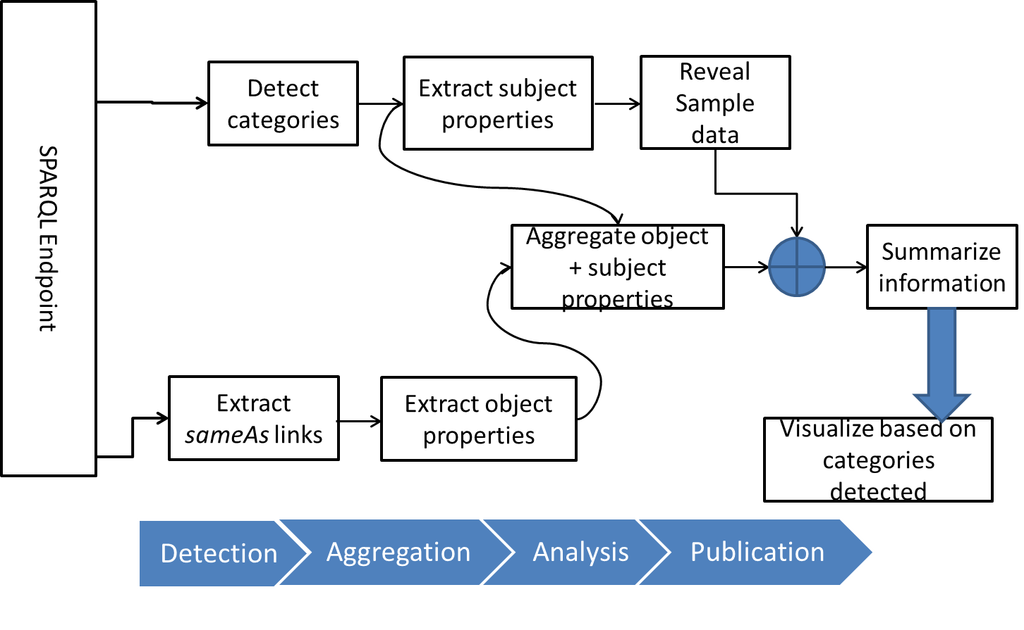
LDVizWiz Workflow

Slide 42
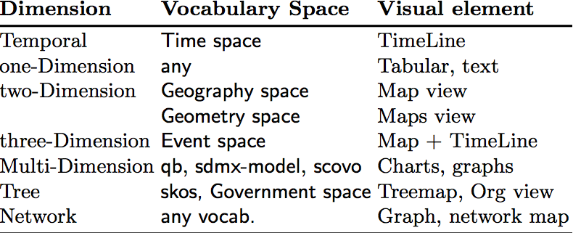

Step 1: Categories detection
Detection of main categories in datasets
ASK SPARQL queries on predefined categories
Uses well-known vocabularies in LOV
Condition the type of visual elements
Detection

Slide 43
Experiment: Categories Detection
Category | Number | %
GEO DATA | 97 | 21.84%
EVENT DATA | 16 | 3.60%
TIME DATA | 27 | 6.08%
SKOS DATA | 02 | 0.45%
ORG DATA | 48 | 10.81%
PERSON DATA | 59 | 13.28%
STAT DATA | 29 | 6.6%
Applications
Automatic detection of endpoints categories
More “trustable” than human tagging
Map categories detected with “suitable” visual elements for the visualizations (e.g., TimeLine +maps for events data)
444 endpoints (*) analyzed, 278 good answers (62.61%) using ASK queries.
Few taxonomies in SKOS, many GEO DATA
(*) All the endpoints retrieved from sparqles.org

Slide 44
Step2: Properties Aggregation
Goal: Exploit the “connectors” between graphs
“connectors” are used to enrich a given graph
e.g., owl:sameAs ; rdfs:seeAlso, skos:exactMatch
Retrieve properties from external datasets
So called “enriched properties”
Build candidate properties for visualization
For pop-up menus
For facet browsing
For charts display
Aggregation
Detection

Slide 45
Step3: Publication
Visualization Generator
Recommend the visual elements based on categories
Transform ASK queries to SELECT or CONSTRUCT queries for input to visual library.
Visualization Publisher
Export the description of visualization in RDF
Add metadata for the visualization (charts) and steps used to create it.
e.g., dcat:Dataset, prov:wasDerivedFrom, void:ExampleResource, chart vocabulary
Publication
Aggregation
Detection

Slide 46
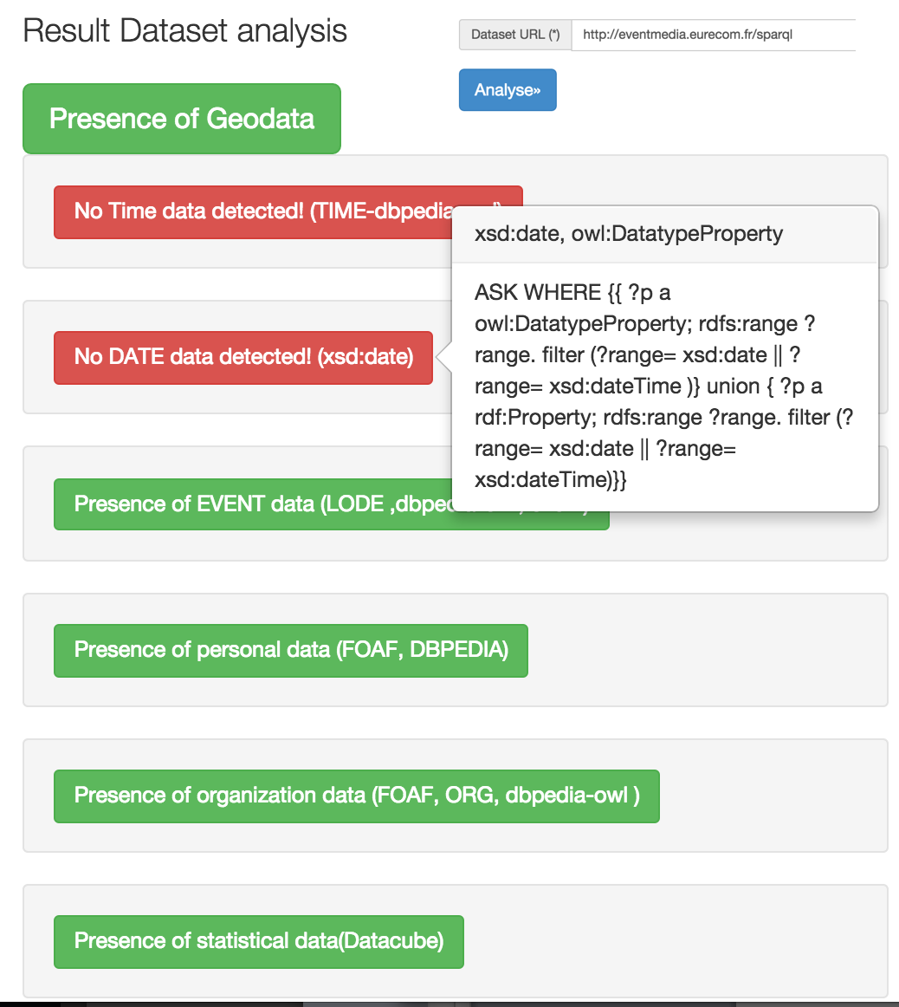
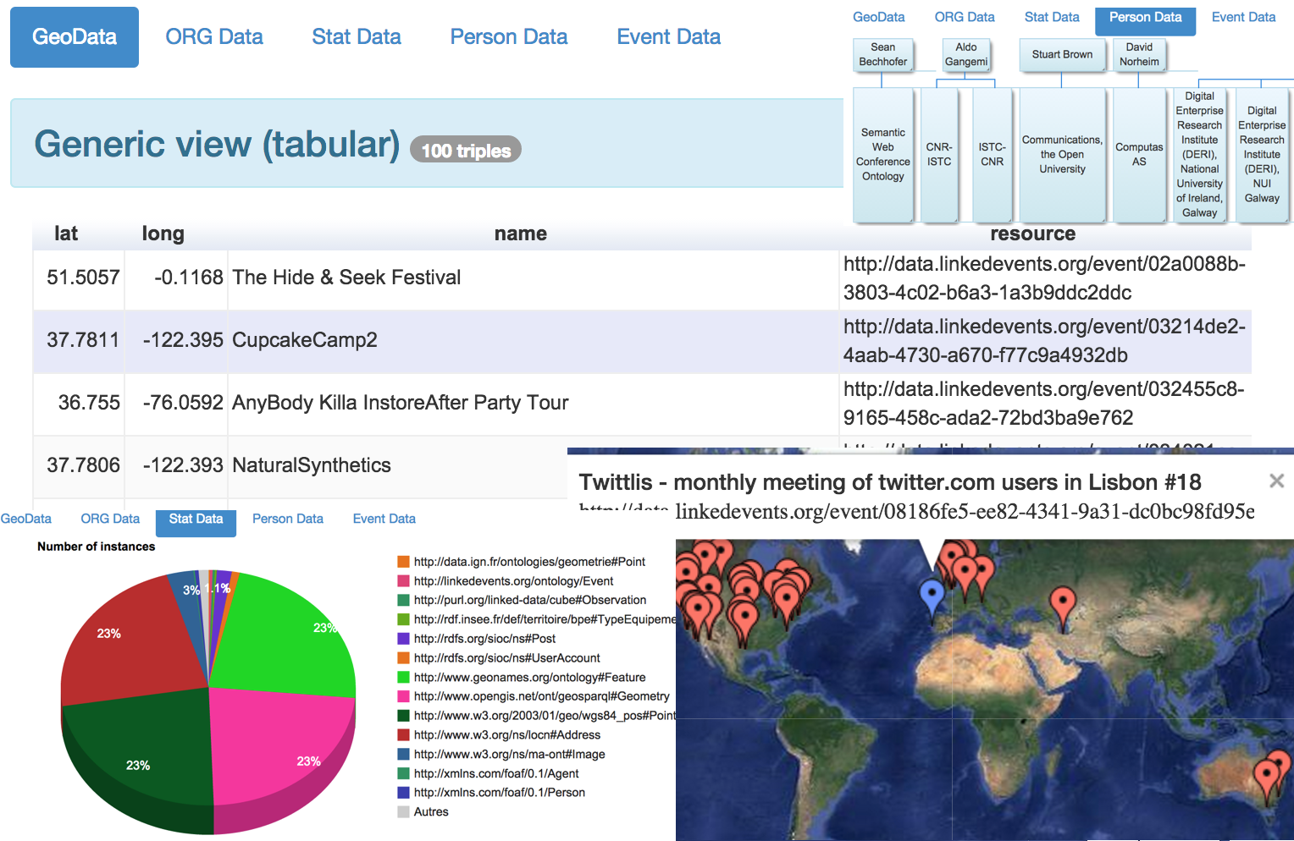
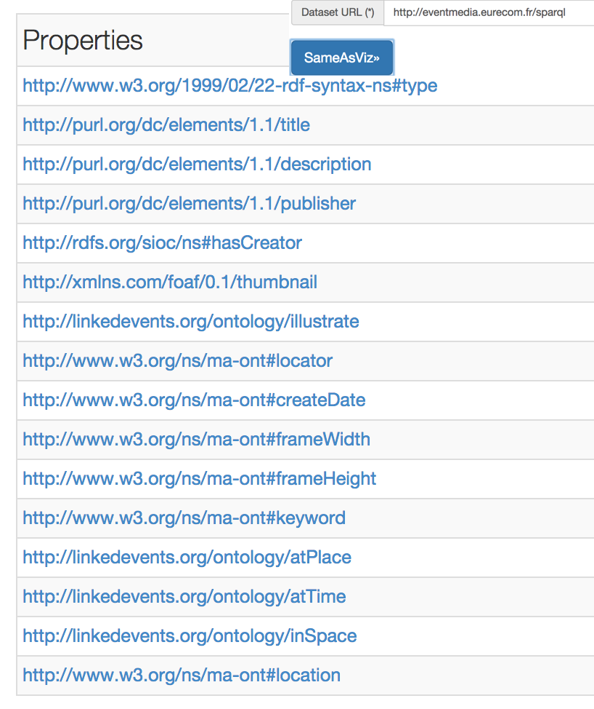
Current Implementation
Javascript light version as “proof-of-concept”
Url: http://semantics.eurecom.fr/datalift/rdfViz/apps/

Slide 47

Best Practices for metadata in vocabularies

Slide 48

W3C Govn’t LD Best Practices
10 best practices to help government worldwide to access and reuse their by taking benefit of Linked Data mechanism.
4 steps to rich 5★ ratings datasets in TimBL scale.

Slide 49
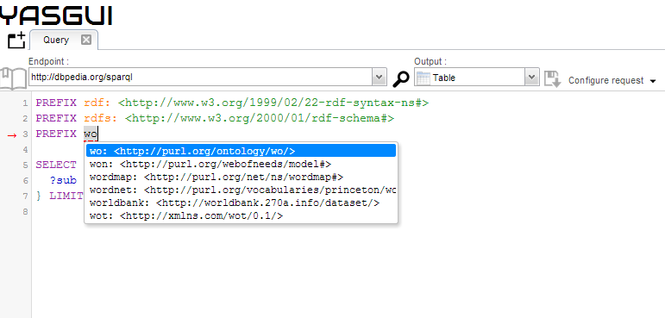

Focus on vocabularies: Disambiguating Vocabulary Prefixes
Goal: align services against Linked Open Vocabularies to harmonize and manage vocabularies’ namespaces
PREFIX.CC
What <wo> namespace
stands for?
LOV

Slide 50
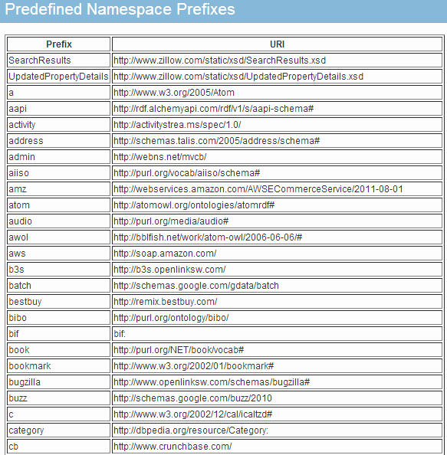
Why if … global use of prefixes
Global namespaces
With good practices to recommend a prefix
Have a more transparent list of built-in prefixes
All the services understand each other with prefixes
Some de facto prefixes emerging: rdfs:, foaf:, rdf: owl:, skos:,

Slide 51



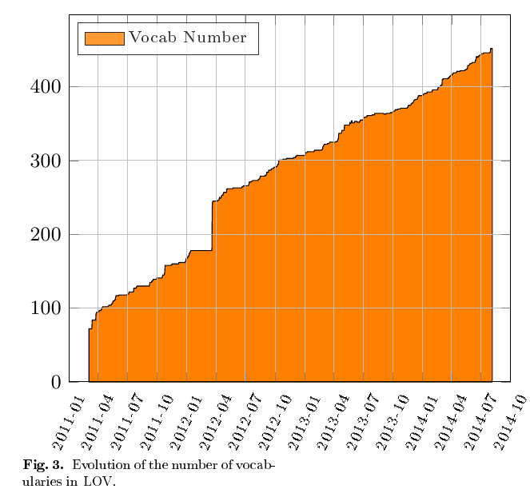
LOV in a Nutshell : http://lov.okfn.org/dataset/lov/
A curated list of vocabularies
More than 450 vocabularies
Each of them described by vocabulary-of-a-friend (voaf)
Provide a dump in N3 of the different versions of a vocabulary
Quasi linearity of the growth, started with 75 vocabularies
The glitch in 2012 corresponds
to the migration to OKFN hosting

Slide 52
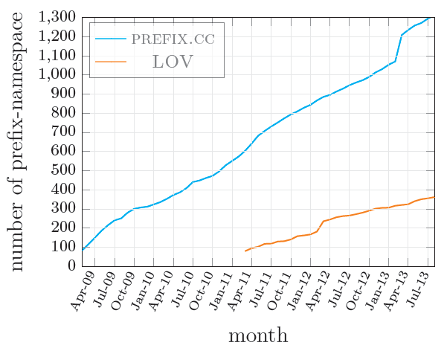
LOV vs PREFIX.CC-Alignment Findings
Category | Number
lov-able vocabs | 227
Intersect-prefixes | 188
vocabs in LOV | 321
vocabs in prefix.cc | 925
⬇
More than 200 prefixes in prefix.cc
are vocabularies

Slide 53
Vocabulary Search and Ranking
Goal: Ranking vocabularies based on Information Content Metrics
Metrics
Information Content Metric (IC): value of information associated with a given entity
Partition Information Content Metric (PIC)
Proposed a ranking based on IC and PIC

Slide 54
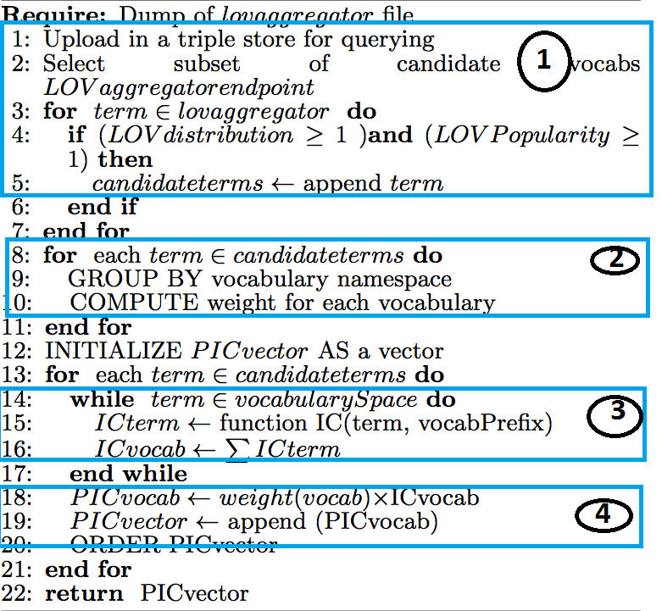
Ranking Algorithm
1- Candidate terms selection in LOV
2- Grouping terms by namespace & weight assignment
3- Compute IC score
4- Compute PIC score
Output ranking

Slide 55
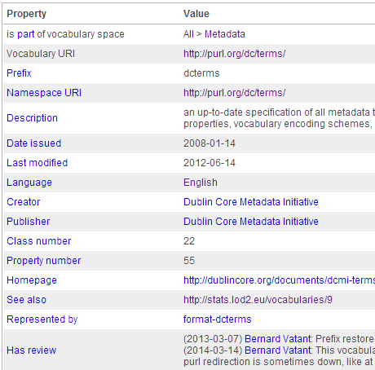
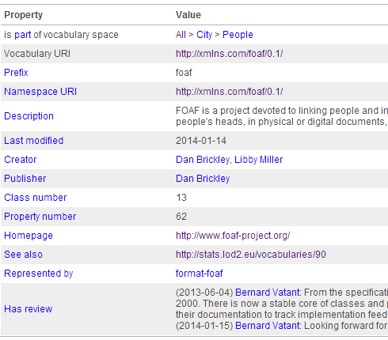
Running Example: dcterms vs foaf
dcterms: http://purl.org/dc/terms/
Candidate terms: 53 (39 properties + 14 classes)
wf = 1+ 2+3 = 6
PIC = 1724.844
foaf: http://xmlns.com/foaf/0.1/
Candidate terms: 35 (26 properties + 9 classes)
wf = 1+ 2+ 3 = 6
PIC = 1033.197
PIC(dcterms) > PIC(foaf)

Slide 56
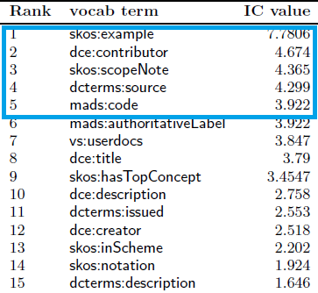
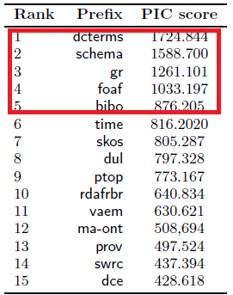
Results on Ranking
Top-15 terms (IC value)
Top-15 vocabs (PIC value)

Slide 57
Applications of the Ranking Metrics
Vocabulary life-cycle management
Help assessing the use of terms and vocabulary updates
Monitoring the use of http://www.w3.org/2003/06/sw-vocab-status/ns#:term_status or owl:deprecated
Semantic Web applications
Vocabularies with higher PIC might be proposed to a user as much as possible, e.g. for choosing properties to display in a facetted browsing interface
Interlinking datasets
Generate sameAs links between resources based on vocabularies terms with lower IC value

Slide 58
Licenses Compatibility
Goal: Reasoning on Licenses for checking compatibilities between vocabularies and datasets
Approach:
Licenses retrieval both for the dataset and for the vocabularies used in the dataset.
Deontic logic to compute compatibility

Slide 59
Our Proposal: LIVE Framework
http://www.eurecom.fr/~atemezin/licenseChecker/
Notes:
The answers to these Use Cases need to do some screen scraping on different html pages of data portals where the applications are described, sometimes without many information nor description.

Slide 60
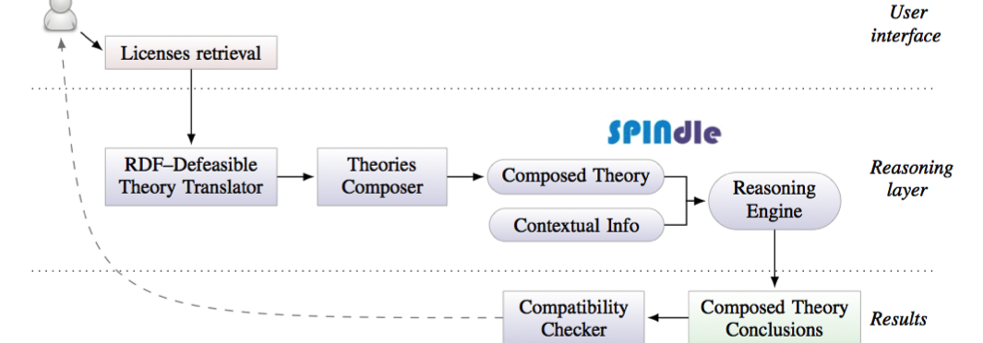
The Logic
RDF licenses: http://purl.org/NET/rdflicense
Logic of deontic rules:
constructive account of basic deontic modalities (obligation, prohibition, permission)
compute the set of all conclusions for each license and then check whether incompatible conclusions are obtained.

Slide 61

LIVE Evaluation
LIVE provides the compatibility in less than 5 seconds for 7 datasets
LIVE retrieves 48 vocabularies in less than 14 seconds
Notes:
*The Apps4Europe project, recently release a big catalog of all Apps in Europe and the goal now is to make some script for populating DVIA.
* Towards Linked Open Visualizations (LOVIZ) catalog

Slide 62
Conclusion
We have presented models for Geodata
For better handling complex geometries
Supporting *all* CRS
For easy querying in SPARQL
We have proposed a generic visualization wizard
Based on predefined categories
Targeted to lay-users
We have contributed in managing vocabulary metadata
Disambiguating prefixes between vocabularies
Improving vocabulary search and ranking
Providing a license compatibility framework
Contributing to Best Practices standard
Notes:
*The Apps4Europe project, recently release a big catalog of all Apps in Europe and the goal now is to make some script for populating DVIA.
* Towards Linked Open Visualizations (LOVIZ) catalog

Slide 63
Future Work
Managing Data updates and versioning
Versioning: integrate Memento protocol?
Spatio-temporal evolution in URIs
Multiple representation: need for metadata?
Level of detail
Geometry modeling rules and reasoning
Tracking Provenance of geodata
To ensure quality of published dataset
To ensure trust from application consumers
Notes:
*The Apps4Europe project, recently release a big catalog of all Apps in Europe and the goal now is to make some script for populating DVIA.
* Towards Linked Open Visualizations (LOVIZ) catalog

Slide 64
Future Work
Visualizations
Extend categories and vocabularies for detection
Provide templates for generating “mash-ups” to combine domains, an mash-up widget generator
Investigate the “importance” of a category in dataset
Provide a user evaluation
Metadata management
Foster and support current effort towards a more sustainable governance of vocabularies.
Compare (P)IC with other graph-based ranking (e.g. pagerank)
Investigate the dependency ranking between vocabularies
Notes:
*The Apps4Europe project, recently release a big catalog of all Apps in Europe and the goal now is to make some script for populating DVIA.
* Towards Linked Open Visualizations (LOVIZ) catalog

Slide 65
Publications
Pierre-Yves Vandenbussche, G.A. Atemezing, Maria Poveda, Bernard Vatant: Linked Open Vocabularies (LOV): a gateway to reusable semantic vocabularies on the Web. Semantic Web Journal, under review, 2015.
G.A. Atemezing, Raphael Troncy: Modeling visualization tools and applications on the Web. Semantic Web Journal, under review, 2015.
G.A. Atemezing et al.: Transforming meteorological data into linked data. In Semantic Web journal, Special Issue on Linked Dataset descriptions, 2012. IOS Press.
Guido Governatori, Ho-Pun Lam, Antonino Rotolo, Serena Villata, G.A. Atemezing and Fabien Gandon: LIVE: a Tool for Checking Licenses Compatibility between Vocabularies and Data.(ISWC 2014, Demo Track)
G.A. Atemezing and Raphael Troncy: Information content based ranking metric for linked open vocabularies. (SEMANTICS 2014)
Ahmad Assaf, G.A. Atemezing, Raphael Troncy and Elena Cabrio: What are the important properties of an entity? Comparing users and knowledge graph point of view. In 11th Extended Semantic Web Conference (Demo Track, ESWC 2014)
Notes:
*The Apps4Europe project, recently release a big catalog of all Apps in Europe and the goal now is to make some script for populating DVIA.
* Towards Linked Open Visualizations (LOVIZ) catalog

Slide 66
Publications
Francois Scharffe, G.A Atemezing, Raphael Troncy, Fabien Gandon, Serena Villata, Bénédicte Bucher, Faycal Hamdi, Laurent Bihanic, Gabriel Kepeklian, Franck Cotton, Jerome Euzenat, Zhengjie Fan, Pierre-Yves Vandenbussche and Bernard Vatant: Enabling linked-data publication with the datalift platform. (AAAI, W10:Semantic Cities, 2012)
G.A. Atemezing and Raphael Troncy: Vers une meilleure interopérabilité des donneés geographiques francaises sur le Web de donneés. (IC 2012).
Houda Khrouf, G.A. Atemezing, Thomas Steiner, Giuseppe Rizzo and Raphael Troncy: Confomaton: A conference enhancer with social media from the cloud. (ESWC 2012, Demo Track)
Bernadette Hyland, G.A. Atemezing and Boris Villazón-Terrazas (editors): Best Practices for Publishing Linked Data. W3C Working Group Note pub- lished on January 9, 2014. URL: http://www.w3.org/TR/ld-bp/
Bernadette Hyland, G.A Atemezing, Michael Pendleton, Biplav Srivastava (editors): Linked Data Glossary. W3C Working Group Note published on June 27, 2013. URL: www.w3.org/TR/ld-glossary/
Notes:
*The Apps4Europe project, recently release a big catalog of all Apps in Europe and the goal now is to make some script for populating DVIA.
* Towards Linked Open Visualizations (LOVIZ) catalog

Slide 67

Thank you for your attention!
Credits Photo:
Bridge: Flickr at https://flic.kr/p/pvwMSf
RDF triples: https://flic.kr/p/dCPFrR

